Slide 1

CAPSTONE PROJECT SESSION BASED RECOMMENDER SYSTEMS
2021-2022 Spring Semester
The American College Of Greece
Michael Koinakis
https://github.com/MichaelKoinakis/capstoneJuly2022

Slide 2
Provided as part of RecSys 2022 Challenge Sessions of users while browsing for items online Items bought at the end of the session Goal is to predict the bought item and provide recommendations
Quick Data Reference
http://www.recsyschallenge.com/2022/

Slide 3
Use Spark and RDDs to group the data into sessions Merge train data and data bought in the end of the session using session ID as key Sort the items in chronological order and group by the session id Write the data in a CSV file for later user
Create user sessions

Slide 4
Use Spark data frames to create a matrix to keep the item features. Index is the item ID Columns are the item features Values are the features values
Create features matrix

Slide 5
Simple modifications of data is faster due to parallelization of processes With Spark, the preprocessing can be applied to bigger volume of data and be deployed to computer clusters
Why Spark ?

Slide 6
Challenges

Slide 7
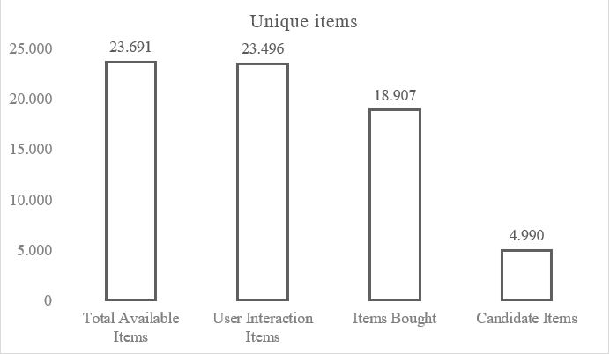
Of all the items: Users interacted with 99% Users have bought 80% Candidate items are 21%
Not all data are used

Slide 8
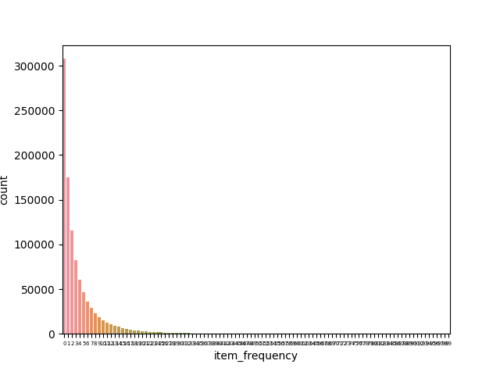
Of all the sessions: 31% have one interaction 89% have maximum ten interactions 11% range from 11 to 100 interactions
Many sessions are small

Slide 9
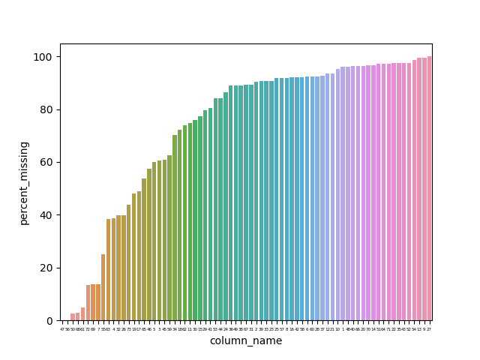
Of all the features: More than 50% of features miss more than 50% of data
Features have many missing values

Slide 10
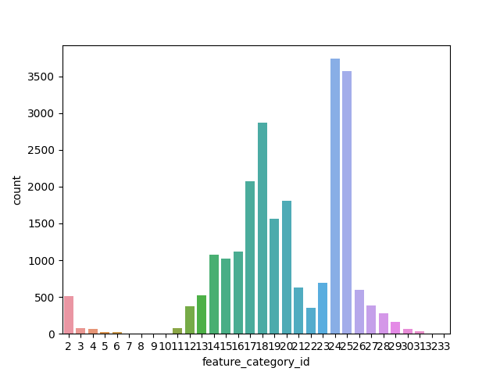
Of all the items: Have on average 20 features 33 is the maximum 2 is the minimum Most items have 12 to 28 features
Features have many missing values

Slide 11
Power Visualization

Slide 12
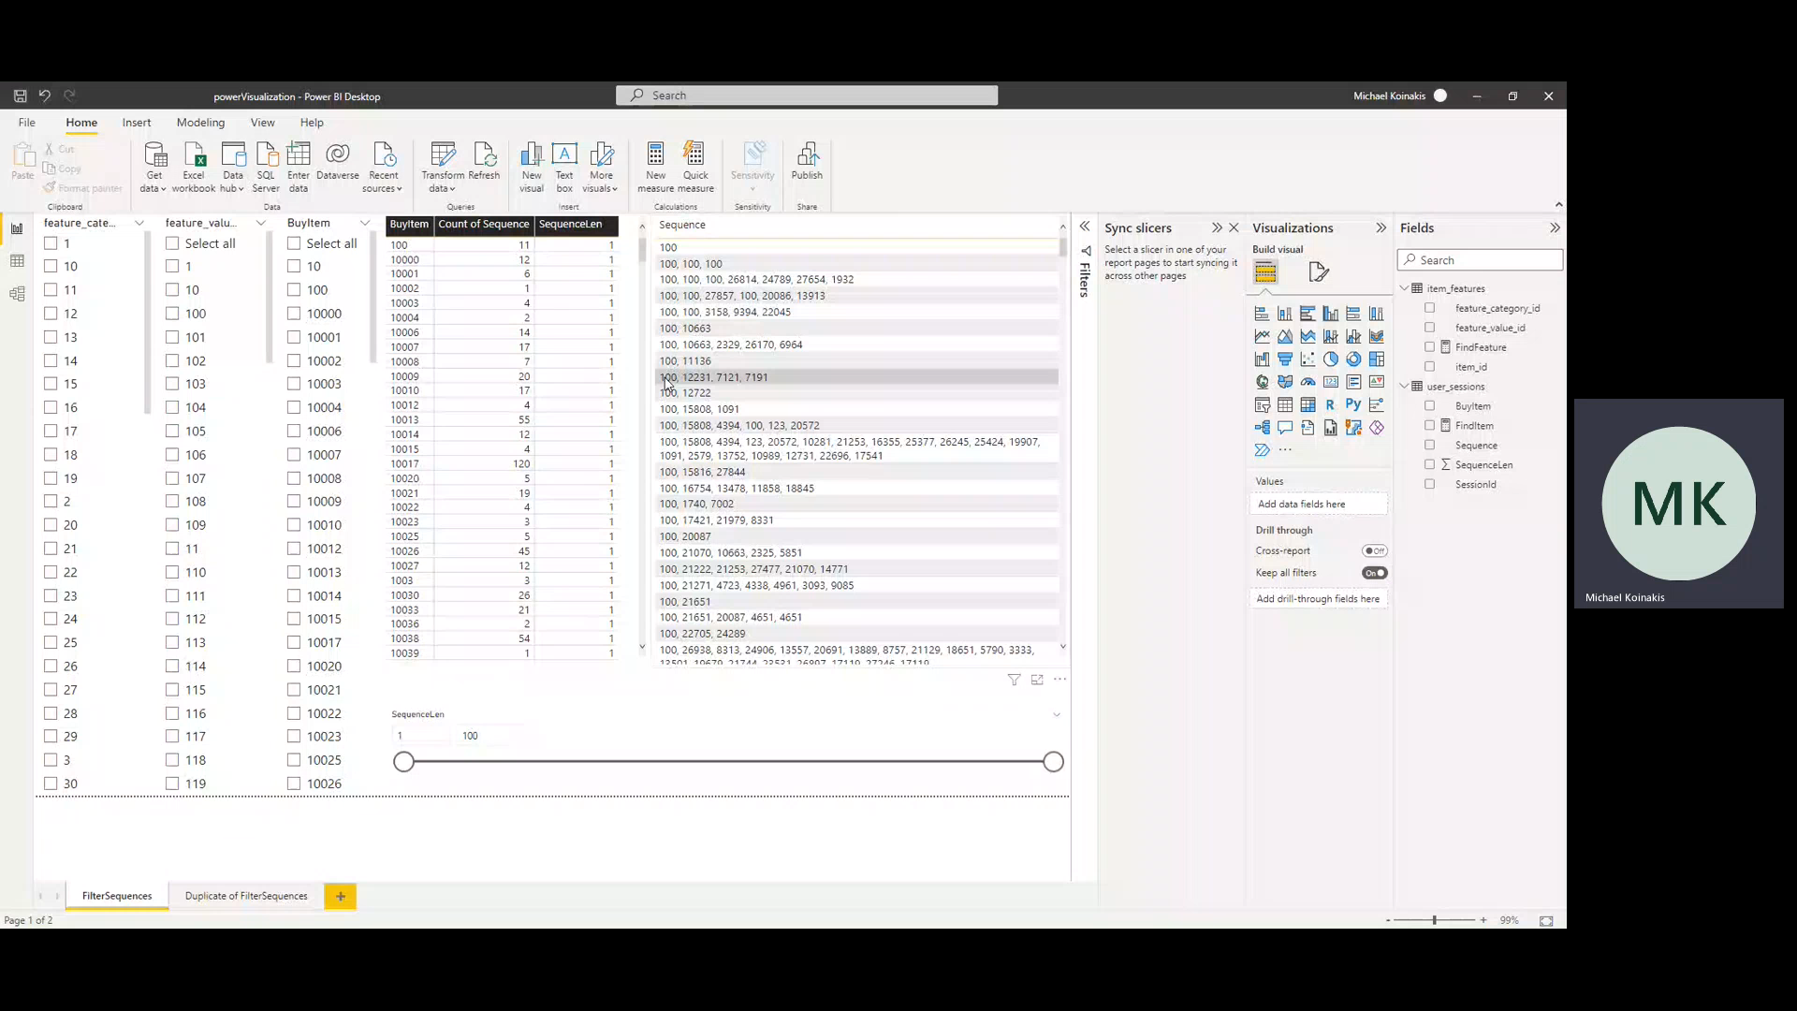

Slide 13
Data Processing

Slide 14
Group items with exactly same features Create teams of same items but different feature values
Grouping Items

Slide 15
Drop features with more than 70% missing values Count the number of dropped features per item in a new feature The features have high cardinality Use Frequency Encoding for the categorical data
Encode Categorical Features

Slide 16
Vote from each item group a representative The item with most sales from each group is the representative Replace the target items with the relative representative from each group
Reduce Possible Output Number

Slide 17
Model Development

Slide 18
Data Pipeline
User Sequence
Encoded Feature Vectors
Average Items Vectors
Produce Recommendations
MLP Model

Slide 19
MLP classifier predicting the item at the end of the session
Deep Neural Network
Input Layer
Shape=(39,)
Batch Normalization
Layer Normalization
Layer Normalization
Layer Normalization
Hidden Layer
Nodes=3.488
Activation = ReLu
Hidden Layer
Nodes=3.488
Activation = ReLu
Hidden Layer
Nodes=3.488
Activation = ReLu
Output Layer
Nodes=872
Activation = Softmax
Dropout Layer
Rate = 0.2
Dropout Layer
Rate = 0.2
Dropout Layer
Rate = 0.2

Slide 20
Loss: Sparse Categorical Cross-entropy Optimizer: Adam Metrics: Sparse Categorical Accuracy, Sparse Categorical Accuracy at 10 Why? Want to measure if the item with most probability is the target item Want to check the model for several recommended items (10)
Metrics

Slide 21
Model trained in batches of 128 For 1.000 epochs (converged after 532) Monitoring the loss – If it does not reduce for 10 epochs, the training stops Test size = 20% Validation size = 20%
Model Training

Slide 22
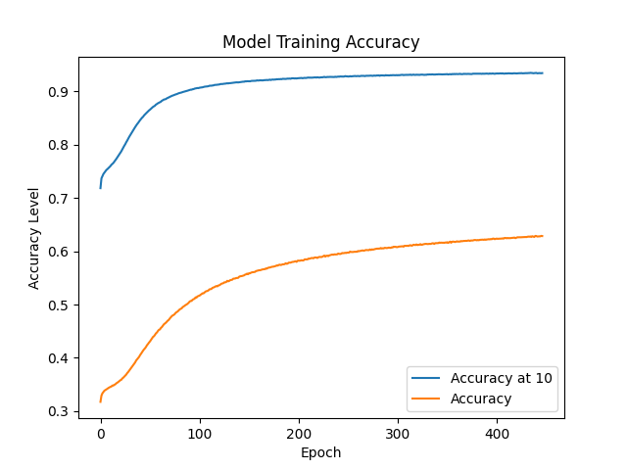
Results
Training Metrics
Loss or Metric | Values on train | Values on validation | Values on test
Sparse categorical cross-entropy | 1,385 | 5,628 | 5,522
Sparse categorical accuracy | 0,618 | 0,315 | 0,298
Sparse categorical accuracy at 10 | 0,932 | 0,712 | 0,695
Classification Metrics
Metric | Value
Precision | 0,57
Recall | 0,60
F1 Score | 0,48

Slide 23
Tune the model to predict items from Candidate Items list to increase Precision and F1 Score Business Evaluation: Click-Through Rate, Adoption & Conversion with data after the deployment of the model Create LSTM model to compare with MLP Truncate or PAD sequences to 6 items length Keep the interactions closer to the buy
Future Work

Slide 24

Thank you

